Slide 1
Disaster Risk Reduction (DRR) - Disaster management cycle – its phases; prevention, mitigation, preparedness, relief and recovery; structural and non-structural measures; risk analysis, vulnerability and capacity assessment. Early warning systems, Post disaster environmental response (water, sanitation, food safety, waste management, disease control, security, communications). Roles and responsibilities of government, community, local institutions, NGOs and other stakeholders; Policies and legislation for disaster risk reduction, DRR programs in India and the activities of National Disaster Management Authority.
UNIT - IV

Slide 2
Disaster Management Cycle

Slide 3
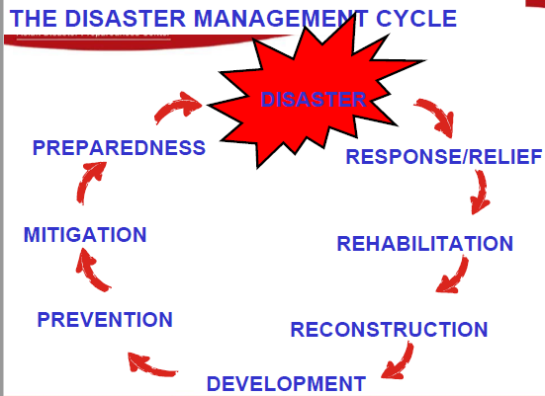

Slide 4
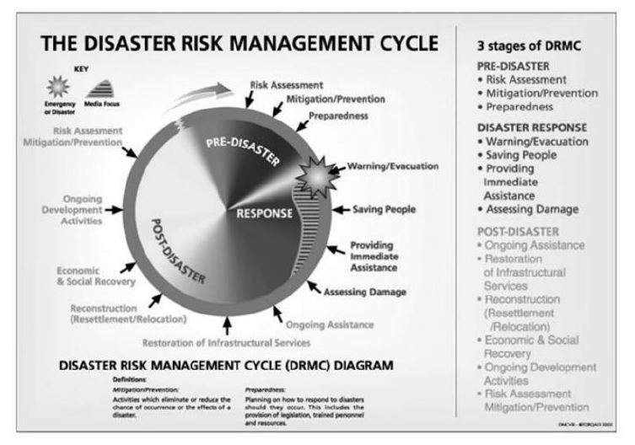

Slide 5
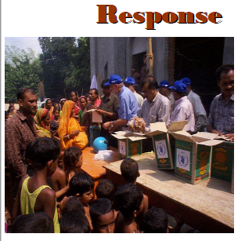

Slide 6
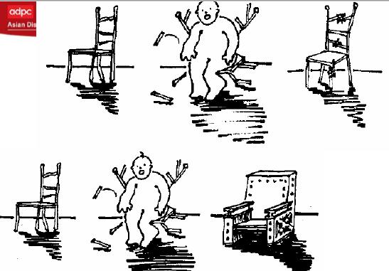

Slide 7
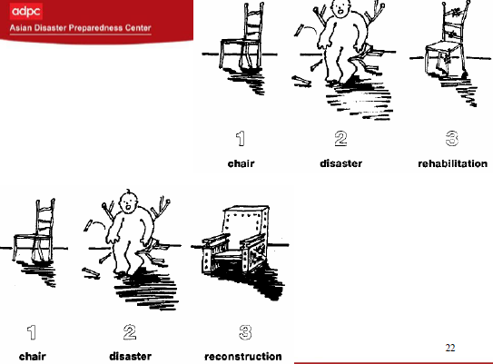

Slide 8
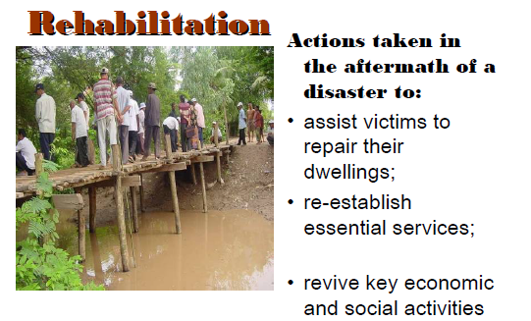

Slide 9
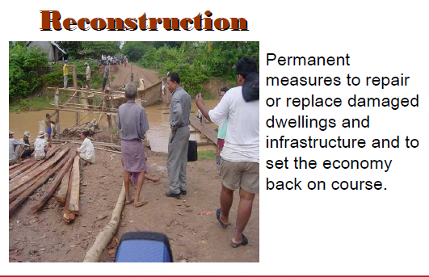

Slide 10
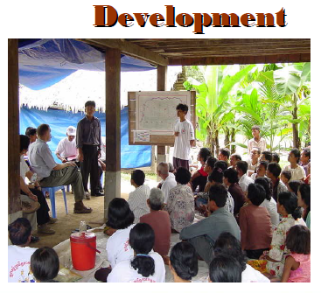

Slide 11
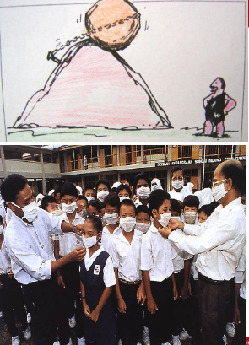
Prevention

Slide 12
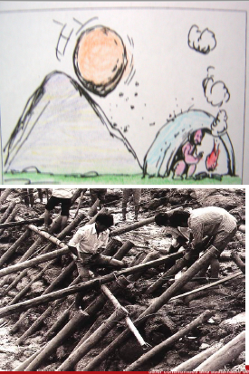
Mitigation

Slide 13
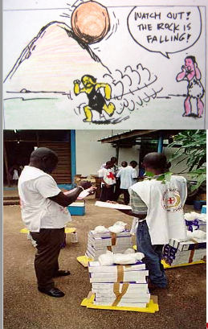
Preparedness

Slide 14
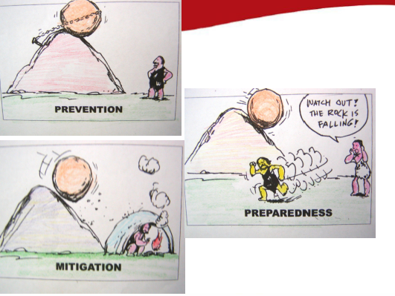

Slide 15
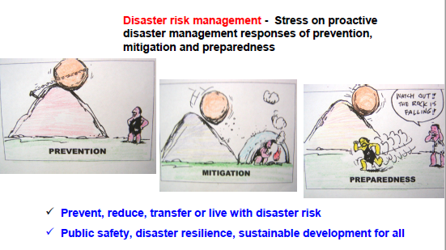

Slide 16
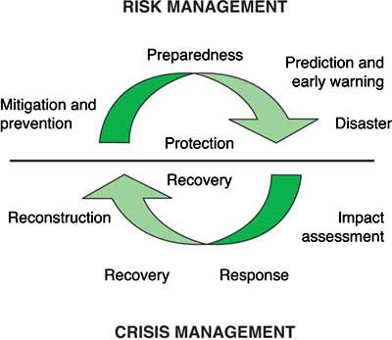

Slide 17
Risk Reduction Strategies
Disaster risk reduction requires a combination of structural and non-structural measures
Structural measures (examples):
Improve construction practice
Retrofit critical structures and lifelines
Non-structural measures (examples):
Improve response capacity
Improve post-disaster assessment and communication capacity
Communicate risk and mitigation measures to various
stakeholders

Slide 18
Construction Practice
Engineered Constructions
Designed and constructed with the assistance of qualified engineers
Design to comply with relevant BIS codes
Non-Engineered Constructions
Constructed without the assistance of qualified
engineers
Most constructions use light-weight roofs Poor seismic resistance expected

Slide 19

What is non - structure
The parts of a building that carry its weight are the structure. Everything else is non- structural.

Slide 20
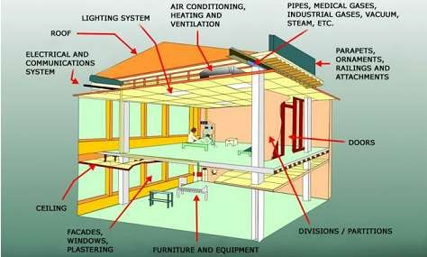
Non-structural Elements

Slide 21
NSM is a new subject regarding earthquake preparedness and we learn new things every day.
In order for NSM to be successful, everyone must be educated and part of the process.
NSM needs to become part of our lives.
Non- Structural Hazards are serious !
50% of the injuries and 3% of the deaths in the 1999
Turkey earthquake damages were caused solely by non-structural hazards !

Slide 22
Non Structural Elements
Architectural Elements
False Ceiling
Windows and partition walls
Parapets and cornices
Stairways
Water tanks
Electrical Systems
Transformers
Lighting
Emergency power

Slide 23
Non Structural Elements
Furnishing and Equipment
Computers
File cabinets
Shelving
Display cabinets
Shop equipment
Lab equipment
Kitchen appliances
Hazardous Materials
Natural gas
Chemicals
Asbestos, lead

Slide 24
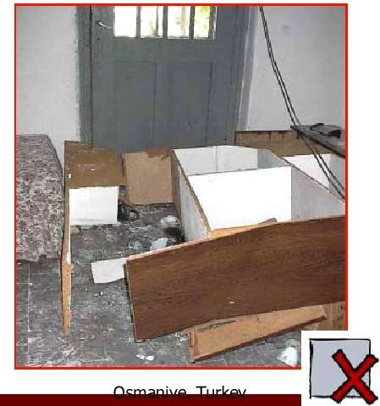
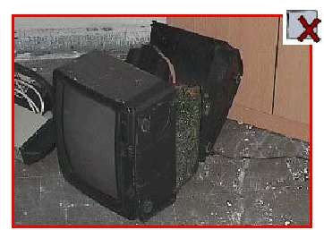
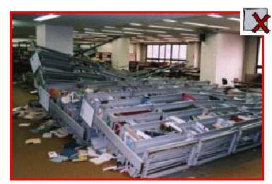
After an earthquake, people may need to quickly, but calmly exit buildings.

Slide 25
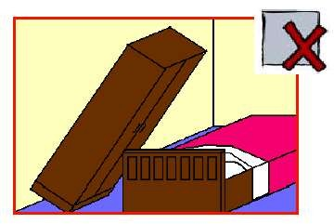
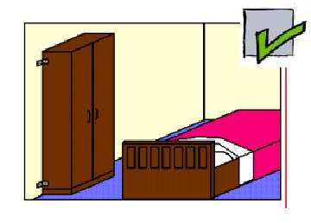

Slide 26
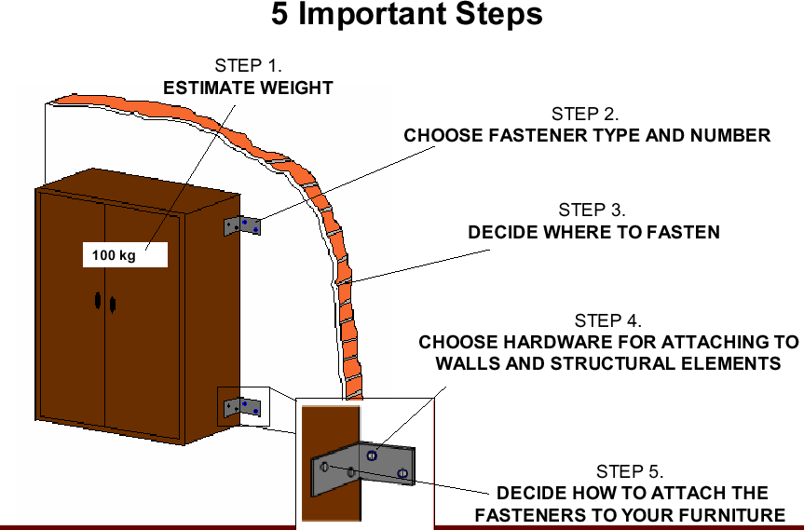
Example of NSM

Slide 27
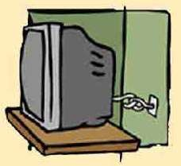

Structural and Non-Structural Measures
Non Structural Mitigation Measures
Small measures to reduce damage like
Fixing of furniture – almirah etc.
Replacing wall clock

Slide 28
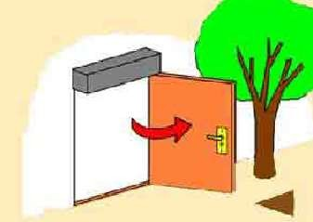

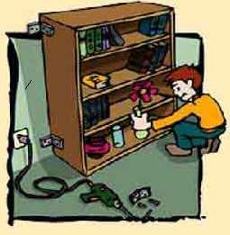
Opening of doors outside
Arranging additional exit in rooms
Plastering glass windows Proper care for chemistry lab Drills

Slide 29
Structural Mitigation Measures
Rebuilding the structure and retrofitting
Retrofitting cost is Rs. 62 lakhs for Ludlow Castle School while rebuilding cost would be Rs. 7 Crore for

Slide 30
VULNERABILITY REDUCTION
Engineering intervention in buildings and structures
Restrictions on land-use to minimise exposure of the society to disaster
Land use restrictions, in the town and country planning laws or
master plan rules.
Earthquake resistance provisions in Municipal bye-laws : Standards are not mandatory and do not form part of the bye- laws of the Local Bodies.
Past earthquakes in Uttarkashi (1991), Latur-Osmanabad (1993), Jabalpur (1997) Chamoli (1999),Kachchh (2001) and Kashmir (2005) have clearly shown lack of implementation of these Codes and Guidelines.

Slide 31
Summing up
Carry out the engineering, architecture and planning measures
Land use zoning.
Planning of habitat,
Implementation of building codes in all new constructions
seismic retrofitting of existing buildings & infrastructure.
Create the supportive structure of
public awareness,
education and training
research and development
Appropriate policy, financial and institutional support at national and state levels need to be provided for putting this strategy into a workable action plan.

Slide 32
Early Warning System(EWS)
The term 'early warning' is used in many fields to describe the provision of information on an emerging dangerous circumstances where that information can enable action in advance to reduce the risks involved
Can be defined as a set of capacities needed to generate and disseminate timely and meaningful warning information of the possible extreme events or disasters (e.g. floods, drought, fire, earthquake and tsunamis) that threatens people‘s lives.

Slide 33
The purpose of this information is to enable individuals, communities and organizations threatened to prepare and act appropriately and in sufficient time to reduce the possibility of harm, loss or risk
Early warning systems exist for natural geophysical and biological hazards, complex socio-political emergencies, industrial hazards, personal health risks and many other related hazards

Slide 34
Elements of early Warning
Early warning is the integration of four main elements
Risk Knowledge
Monitoring and Predicting
Disseminating Information
Response

Slide 35
Risk Knowledge:
Risk assessment provides essential information to set priorities for mitigation and prevention strategies and designing early warning systems.
Monitoring and Predicting:
Systems with monitoring and predicting capabilities provide timely estimates of the potential risk faced by communities, economies and the environment.
Disseminating Information:
Communication systems are needed for delivering warning messages to the potentially affected locations to alert local and regional governmental agencies. The messages need to be reliable, synthetic and simple to be understood by authorities and public.
Response:
Coordination, good governance and appropriate action plans are a key point in effective early warning. Likewise, public awareness and education are critical aspects of disaster mitigation.

Slide 36
The purpose of early warning systems is to detect, forecast, and when necessary, issue alerts related to impending hazard events.
Early warning needs to be supported by information about the actual and potential risks that a hazard poses, as well as the measures people can take to prepare for and mitigate its adverse impacts.
Early warning information needs to be communicated in people friendly manner in such a way that facilitates decision-making and timely action of response organizations and vulnerable groups.
Early warning information comes from different meteorological offices (for weather related disasters- flood, cyclone etc.); Ministries of Health (for example, disease outbreaks) and Agriculture (for example, crop forecasts); local and indigenous sources; media sources and increasingly from Internet early warning services.

Slide 37
Need of Early Warning System
Early Warning for disaster reduction is a legitimate matter of public policy at the highest national levels for two main reasons:
The first one, clearly, is public safety, and the protection of human lives.
The second is the protection of the nation‘s resource base and productive assets (infrastructure and private property or investments) to ensure long-term development and economic growth. Conversely, by reducing the impact of disasters, a government avoids the financial –and political- burden of massive rehabilitation costs.

Slide 38
Investing in early warning and other measures of disaster reduction is neither simple nor inexpensive, but the benefits of doing so, and the costs of failing to, are considerable
For instance:
In terms of reducing economic losses, early warning and disaster preparedness “pay for themselves” many times over the life of the warning system.
The reduction of environmental losses can, if properly managed and publicized, have both long-term benefits to the economy, and short-term benefits for the administration in-charge.
A country can strengthen its stature and influence in international relations by a good handling of externalities‘, or indirect effects, on neighbouring nations.
From a public policy viewpoint, early warning, disaster preparedness and prevention must be part of a single, well integrated process

Slide 39
Communication of early warning information
An effective early warning system needs an effective communication system. Early warning communication systems are made of two main components:
communication infrastructure hardware that must be reliable and robust, especially during the natural disasters
Appropriate and effective interactions among the main actors of the early warning process such as the scientific community, stakeholders, decision makers, the public, and the media.
Many communication tools are currently available for warning dissemination such as Short Message Service (SMS) (cellular phone text messaging), email, radio, TV, and web service.

Slide 40
Information and communication technology (ICT) is a key element in early warning.
ICT plays an important role in disaster communication and dissemination of information to organizations in charge of responding to warnings and to the public during and after a disaster.
Redundancy of communication systems is essential for disaster management, while emergency power supplies and back-up systems are critical in order to avoid the collapse of communication systems after disasters occur.

Slide 41
Community Based Early Warning System
Early warning systems have limitations in terms of saving lives if they are not combined with “people-centered” networks.
To be effective, early warning systems must be understandable, trusted by and relevant to the communities that they serve.
Warnings will have little value unless they reach the people most at risk, who need to be trained to respond appropriately to an approaching hazard.

Slide 42
Community-Based Early Warning Systems (CBEWS) are anchored in the communities and managed by the communities.
It is based on a "people-centered" approach that empowers individuals and communities threatened by hazards to act in sufficient time and in an appropriate manner in a bid to reduce the possibility of personal injury, loss of life, damage to property, environment and loss of livelihood.
It provides communities, practitioners and organizations involved in disaster risk management with advance information of risks that can be readily translated into prevention, preparedness and response actions.
CBEWS helps to reduce economic losses by allowing people to better protect their assets and livelihood.

Slide 43
Essential features of community-based early warning systems are:
All community members especially the vulnerable groups should be involved at all stages of the CBEWS from designing to operating the systems, receiving the warning messages and responding to the warning.
Measures taken should be based on the needs of everyone in the community including the most vulnerable segments of the community.
The community members will own the process and system.
CBEWS measures will enhance the capacity of the community members to deal with their situation.
Meaningful participation in the decision-making process of EWS.

Slide 44
Early warning systems and policy
For early warning systems to be effective, it is essential that they be integrated into policies for disaster mitigation.
Good governance priorities include protecting the public from disasters through the implementation of disaster risk reduction policies.
It is clear that natural phenomena cannot be prevented, but their human, socio-economic and environmental impacts can and should be minimized through appropriate measures, including risk and vulnerability reduction strategies, early warning, and appropriate action plans.
Most often, these problems are given attention during or immediately after a disaster.

Slide 45
Disaster risk reduction measures require long term plans and early warning should be seen as a strategy to effectively reduce the growing vulnerability of communities and assets.
The information provided by early warning systems enables authorities and institutions at various levels to immediately and effectively respond to a disaster.
It is crucial that local government, local institutions, and communities be involved in the entire policy making process, so they are fully aware and prepared to respond with short and long-term action plans.

Slide 46
Understand the most likely threats, likelihood of disasters and their potential consequences
Although natural disasters are not precisely predictable, they are most often generally foreseeable.
In other words, there are many areas where the occurrence of floods is likely; one does not necessarily know exactly when, but one knows they will occur sooner or later.
Many natural hazards can be foreseen, or anticipated, from past experience, the analysis of current patterns of land use, or population distribution.

Slide 47
Establish proper priorities
To allocate scarce resources most wisely, decision makers must rely on the type of analysis above, and make the disaster management choices which have the highest ‘value‘, in terms of losses avoided.
One common approach is to use the expected value criteria; that is, the likelihood of an event multiplied by the potential cost of this event if it occurred. Simply stated, it is a matter of giving priority to the “worst-most likely‘ over the “ most benign-least likely‘ events.

Slide 48
Developing institutional networks with clear responsibilities
Understanding the nature of natural hazards and related vulnerabilities, for early warning purposes, requires a combination of actors from several areas, such as science and research (including social sciences and cultural aspects), land use planning, environment, finance, development, education, health, energy, communications, transportation, labor and social security as well as national defence.
On the other hand, a prompt and effective response to a disaster, based on early warning, implies that concerted action –managed by a higher authority—be taken by specific types of institutions: civil defence or public safety personnel, power and other utility agencies or companies, public health authorities, etc. at levels ranging from the cabinet minister‘s to the community leaders.

Slide 49
Establish or strengthen the legislative/legal framework and mechanisms
Just as for any other aspect of public policy, early warning systems, as well as other disaster reduction applications need to be motivated and based within governmental responsibilities, especially since response to disasters may require exceptional executive powers for a specific period of time but its success cannot be accomplished without the benefits of widespread decision making and the participation of many others.

Slide 50
Developing effective communication strategies
The context of early warning system communications has two aspects; the hardware aspect relates to the maintenance of lifelines, i.e. the necessity to build or strengthen robust hazard-resistant communication systems; the software aspect relates to the maintenance of relationships, i.e. the need to establish and maintain effective links and working relationships among the actors involved in the early warning communication chain.

Slide 51
Securing resources
A substantial amount of resources is needed to ensure monitoring, adequate early warning, concerted disaster reduction, and a return to normal life.
To a great extent, the capacity to secure resources to do this versus undertaking a competing public program—depends on the quality and credibility of the overall system
understanding threats, clear priority setting and institutional networks, and appropriate legislative dialogue.

Slide 52
Post disaster environmental response
As the impacts of climate change and its attendant problems (such as global warming or sea-level raise) increases, policy focus is increasingly shifting towards disaster management at the local level - preparedness and response to disasters, but also to recovery and mitigation.
It is now moving mainstream among disaster professionals (who were initially focused only on disaster preparedness and response, and who now seek such cross disciplinary linkages).
A poorly managed local environment can increase the risks that humans face from disaster events.
For example:Manila, Philippines - annual flooding happening in the Philippine capital has frequently been attributable not to heavy rains or climate change, but to inappropriate waste management that has clogged drainage channels, resulting in flooding.
Toyooka, Japan - a medium strength typhoon had devastating impact on this city because of poor forest management. The typhoon picked iup forest debris from the mountains surrounding the city and blocked rivers in the city, resulting in extensive flooding

Slide 53
Post disaster or third stage of Disaster management cycle
It involves the initial actions taken as the event takes places
It involves efforts to minimize the hazards created by a disaster
Ex: evacuation, search & rescue, emergency relief

Slide 54
Water
Do not use water u suspect or have been told to be contaminated for daily use right from washing utensils to cooking food
Safe water for drinking cooking & personal hygiene includes bottled, boiled or treated water
our state local or tribal health dept. can make specific recommendations for boiling or treating water in your area.

Slide 55
Safe drinking water
After an emergency especially after floods drinking water may not be available or safe to drink
Alcohol dehydrates the body which increases the need for drinking water so-avoid consumption of alcohol
Floods & other disasters can damage drinking water wells & leads to aquifer & well contamination
Flood water can contaminate well water with livestock, waste human sewage, chemicals & other containments which can lead to illness when used for drinking & cooking
If your water comes from a private well that has been flooded consider the following guidelines for making the water safe and for emergency water source until you are certain that your water is free from containment & safe to drink

Slide 56
Make water safe :
Water often can be made safe to drink by boiling, adding disinfectants, filtration
Water containing contaminated with fuel or toxic chemicals will not be made safe by boiling or disinfection
Use the different source of water if know or suspect that water might be contaminated with fuel or toxic chemicals
Finding emergency water source:
Alternate source of clean water can be found inside or outside the home don't drink water that has an un usual odour or colour or pathogens.

Slide 57
SANITATION
Good basic personal hygiene and handwashing are critical to help prevent the spread of illness and disease. Clean safe running water essential for proper hygiene and handwashing.
Hygiene is especially important in an emergency such as a flood, hurricane or earthquake, but finding clean running water can sometimes be difficult
The following are good sanitation steps to be followed
handwashing
bathing
dental hygiene
wound care

Slide 58
FOOD SAFETY
Food that comes with flood water or thrown away,, perishable foods that have not been refrigerated properly due to power cut, and those with unusual odour, colour or texture should not be consumed.
Unsafe food can make you sick even if it looks, smells and tastes normal.
Steps to be followed for having safe food
throw away following foods
how to reuse commercially prepared cans and retort pouches
store food safely
clean and sanitized food contact surfaces that have been flooded.

Slide 59
WASTE MANAGEMENT
Should attract much social attention
Adverse affects on water quality , air quality ,flora and fauna
Waste management is a key issue among several dimensions in rehabilitation of environment
Proper planning is at most important
Management of debris is involved at recovery stage
Damaged buildings need to be recycled
Disposable of debris is the main challenge
Codal provisions for disposing waste has to be implemented
Control of generation of waste, storage, collection , transfer and transport , processing , reuse and recovery and disposal

Slide 60
DISEASE CONTROL
In Recent decades millions of people have been killed by natural disasters resulting in economic damages
Disasters dramatically increase the mortality due to communicable diseases
Causes of diseases
Food & water contamination
Respiratory infections
Vector and insect born diseases
Infections due to wounds & injuries

Slide 61
Water born diseases
Diarrheal,
hepatitis,
leptospirosis,
diseases associated with crowding ,
vector borne diseases,
Infections due to wounds and injuries

Slide 62
SECURITY
Environmental security was identified as a core component of the definition, under UNDP’s 1994 report.

Slide 63
COMMUNICATION
cv

Slide 64
Response
Instructions
1. Identify one area for disaster response & recovery
2. Identify 6 or more factors influencing resilience after disaster
3. Construct a simple system connection circle between the different factors
4. Brainstorm innovative ideas for decreasing hazard; decreasing exposure, decreasing vulnerability, and increasing capacity

Slide 65
After Immediate Rescue and Response, then what?
First things first:
there are people to rescue, mouths to feed.
Medical supplies to distribute,
bodies to bury, law and order to reinstate.
But what next? When the immediate threat from the hazard has passed, when the suddenly homeless take stock and regard the obliterated ruins of their city, where do you start? How do you rebuild a city?

Slide 66
Response
Instructions
1. Identify one area for disaster response & recovery
2. Identify 6 or more factors influencing resilience after disaster
3. Construct a simple system connection circle between the different factors
4. Brainstorm innovative ideas for decreasing hazard; decreasing exposure, decreasing vulnerability, and increasing capacity

Slide 67
After Immediate Rescue and Response, then what?
First things first:
there are people to rescue, mouths to feed.
Medical supplies to distribute,
bodies to bury, law and order to reinstate.
But what next? When the immediate threat from the hazard has passed, when the suddenly homeless take stock and regard the obliterated ruins of their city, where do you start? How do you rebuild a city?

Slide 68
Powers and functions of State Authority.
A State Authority shall have the responsibility for laying down policies and plans for disaster management in the State.
Without prejudice to the generality of provisions contained in sub-section (1), the State Authority may-
lay down the State disaster management policy.
Approve the State Plan in accordance with the guidelines laid down by the National Authority.
Approve the disaster management plans prepared by the departments of the Government of the State.
lay down guidelines to be followed by the departments of the Government of the State for the purposes of integration of measures for prevention of disasters and mitigation in their development plans and projects and provide necessary technical assistance therefore.

Slide 69
coordinate the implementation of the State Plan.
recommend provision of funds for mitigation and preparedness measures.
review the development plans of the different departments of the State and ensure that prevention and mitigation measures are integrated therein.
review the measures being taken for mitigation, capacity building and preparedness by the departments of the Government of the State and issue such guidelines as may be necessary.
The Chairperson of the State Authority shall, in the case of emergency, have power to exercise all or any of the powers of the State Authority but the exercise of such powers shall be subject to ex post facto ratification of the State Authority".

Slide 70
Guidelines for minimum standard of relief by State Authority.
The State Authority shall lay down detailed guidelines for providing standards of relief to persons affected by disaster in the State,
such standards shall in no case be less than the minimum standards in the guidelines laid down by the National Authority in this regard.
The Act also provides for State Executive Committee (SEC) for the State headed by the Chief Secretary and others as members to assist the SDMA in performing the functions prescribed by the Act.
SEC is the executive arm of the SDMA.

Slide 71
The sum up of the responsibilities of the SDMA and SEC are as under:
Development of awareness campaign strategy and its implementation in the state.
Development of Human Resource Plan for implementation thereof – development of training modules and material
Preparation or updation of state disaster management plan to ensure that the issues of DRR have been addressed
To initiating risk and vulnerability assessments and preparation of annual vulnerability and risk reduction reports.
Laying down guidelines to integrate DRR into development process
Follow up with various line departments to ensure that DRR issues have been addressed in their development plans.

Slide 72
Preparation of Disaster Risk Reduction Projects in various sectors.
Carrying out DRR Audit of the development plans prepared by line departments.
Developing a Recovery framework for the state.
Development of Knowledge and information sharing platform in DRR
Conceptualizing and formulating projects and programmes as a part of the national initiatives/schemes.
Preparation of Minimum Standards of Relief
Preparation of Disaster Management Policy
Preparation of Mitigation plans

Slide 73
Coordinate and monitor the implementation of National Policy, National Plan and State Plan
Lay down guidelines for the preparation of DMP by various departments
Lay down guidelines for safe construction practices and ensure compliance thereof
Provide necessary technical assistance or give advice to District Authorities.
Lay down, review and update state level response plans and guidelines
Ensuring the communication system is in order – setting up and strengthening of EOCs
Ensuring the conduct of mock drills regularly.

